Slide 1

Empowering Micro and Small Enterprises: A Mobile App Solution
Enhancing Quality, Reducing Costs, and Managing Waste

Slide 2
INTRODUCTION
Introduction: In today's fast-paced business environment, micro and small enterprises (MSEs) face numerous challenges that hinder their growth and sustainability.
Emphasizing Local Impact: MSEs, often the backbone of local economies, play a pivotal role in job creation, community development, and economic resilience. Their success is intertwined with the prosperity of our communities.
Objective of the Presentation: Our objective today is to shed light on the critical challenges faced by MSEs, with a particular focus on cost management, quality control, and waste management. We will also introduce a transformative mobile app solution designed to empower MSEs and drive positive change in their operations.

Slide 3
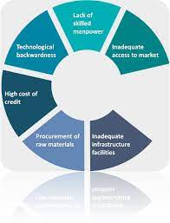
Challenges Faced by MSEs
Cost, Quality, and Waste Management Challenges
Cost Management Challenges: Micro and Small Enterprises (MSEs) are grappling with tight budgets and resource constraints. They often struggle to optimize operational costs, leading to financial strain and reduced competitiveness.
Quality Control Issues: Ensuring consistent product or service quality is a formidable challenge for MSEs. Maintaining quality standards and meeting customer expectations can be difficult due to limited resources and capacity.
Waste Management Dilemma: MSEs face waste management challenges that impact both their bottom line and the environment. Proper disposal of waste, recycling, and adopting sustainable practices can be daunting tasks for these businesses.

Slide 4
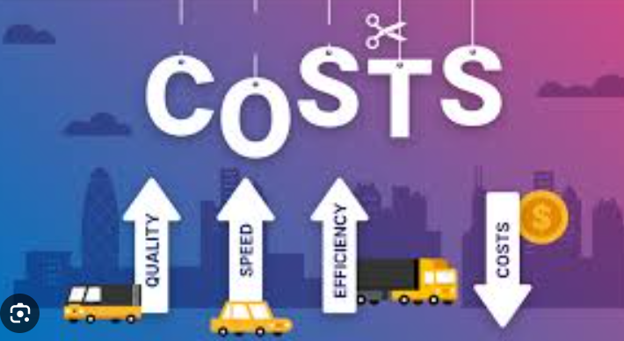
Cost Challenges
Navigating Tight Budgets
Limited Access to Capital
High Raw Material Costs
Price Pressure
Labor Cost Management
Equipment Expenses
Reduced Investment
Consequences of Neglected Costs

Slide 5

Quality Challenges
Meeting Quality Standards
Resource Constraints
Limited Expertise
Supply Chain Issues
Real-life Example
Customer Satisfaction
Market Access
Long-term Impact

Slide 6

Waste Management Challenges
Minimizing Waste for Sustainability
Resource Constraints
Environmental Impact
Case Study
Regulatory Compliance
Sustainable Practices
Statistics
Long-term Sustainability

Slide 7
The Proposed Mobile App Solution
Revolutionizing MSE Operations
Overcoming Challenges
Introduction to the Mobile App
Game-Changer for MSEs
Addressing Cost Challenges
Enhancing Quality Control
Optimizing Waste Management
User-Friendly Interface
Adaptability and Scalability
Collaborative Partnerships
Training and Education
Sourcing Eco-Friendly Suppliers
Market Access Enhancement

Slide 8
Key Features of the App
Direct Business-Customer Interaction
Streamlined Logistics
Secure Transactions
Data Insights
Capacity-Building Resources

Slide 9
Benefits of the Solution
Cost Reduction
Enhanced Quality Control
Efficient Waste Management
Increased Market Access
Improved Sustainability
Success Story

Slide 10
Data Security and Scalability
Ensuring Trust and Growth
Importance of Data Security
Scalability and Regional Adaptability
Compliance with Regulations

Slide 11
Conclusion and Q&A
Summary of Key Points
Empowering MSEs
Transformative Impact
Data Security and Scalability
Local Economic Contribution
Invitation for Questions and Discussions

Slide 12
THANK YOU

Slide 13
7 lines in each slide
Conclu introdu
Propo
Existin
Website

